Slide 1
Front-End Developer 21 – 28.03.2018
Sinisa Vrhovac

Slide 2
Sadržaj časa
CSS

Slide 3
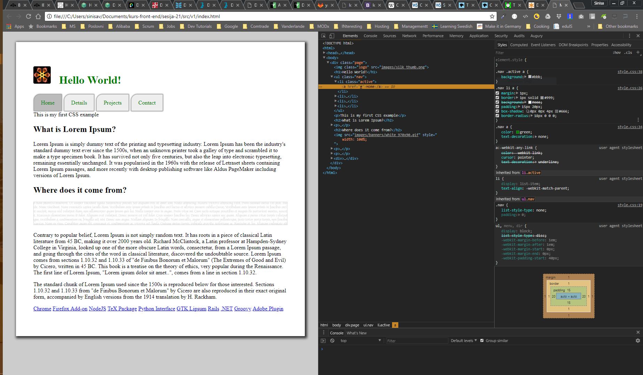
Ponavljanje je majka znanja ☺

Slide 4
Današnje teme
Layouts,
Responsive design,
Media queries
Notes:
https://www.w3.org/Style/CSS/
The CSS 1 specification was completed in 1996. Microsoft's Internet Explorer 3[19] was released in that year, featuring some limited support for CSS. IE 4 and Netscape 4.x added more support, but it was typically incomplete and had many bugs that prevented CSS from being usefully adopted. It was more than three years before any web browser achieved near-full implementation of the specification.
CSS 1: The first CSS specification to become an official W3C Recommendation is CSS level 1, published on December 17, 1996.
Among its capabilities are support for:
Font properties such as typeface and emphasis
Color of text, backgrounds, and other elements
Text attributes such as spacing between words, letters, and lines of text
Alignment of text, images, tables and other elements
Margin, border, padding, and positioning for most elements
Unique identification and generic classification of groups of attributes
The W3C no longer maintains the CSS 1 Recommendation.
CSS 2
CSS level 2 specification was developed by the W3C and published as a recommendation in May 1998. A superset of CSS 1, CSS 2 includes a number of new capabilities like absolute, relative, and fixed positioning of elements and z-index, the concept of media types, support for aural style sheets (which were later replaced by the CSS 3 speech modules)[39] and bidirectional text, and new font properties such as shadows.
The W3C no longer maintains the CSS 2 recommendation.
CSS 3: Unlike CSS 2, which is a large single specification defining various features, CSS 3 is divided into several separate documents called "modules". Each module adds new capabilities or extends features defined in CSS 2, preserving backward compatibility. Work on CSS level 3 started around the time of publication of the original CSS 2 recommendation.
The earliest CSS 3 drafts were published in June 1999.
Due to the modularization, different modules have different stability and statuses.

Slide 5
CSS size units
Numeric units:
px - Pixels,
mm, cm, in, pt, pc;
Relative units:
em - 1em je veličina fonta u trenutnom elementu, preciznije, širina M
rem - (root em) Je isto što i em, ali u odnosu na base font brovsera
vw, vh – Je 1/100 delova širine odnosno visine vidljivog dijela ekrana

Slide 6
Još selektora
*
[] : a[title], a[href="..."] {color: red;}
+ : img + p {color: red;}
~ : img ~ p {color: red;}
> : ul.my-things > li {margin: 2em;}
:hover
:active
:checked
:empty
:enabled :disabled
:first-child :last-child
:nth-last-child(n)

Slide 7
CSS Layout

Slide 8
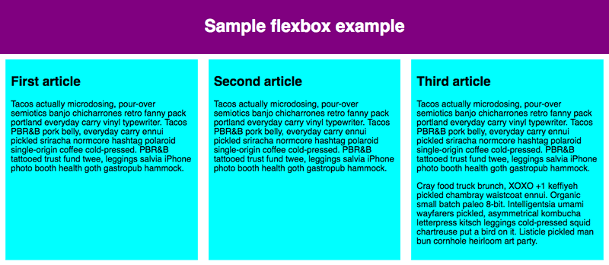
Flex

Slide 9
Flex
div {
display: flex;
flex-direction: column;
align-items: center;
justify-content: space-around;
flex-wrap: wrap;
}
flex: 200px;

Slide 10
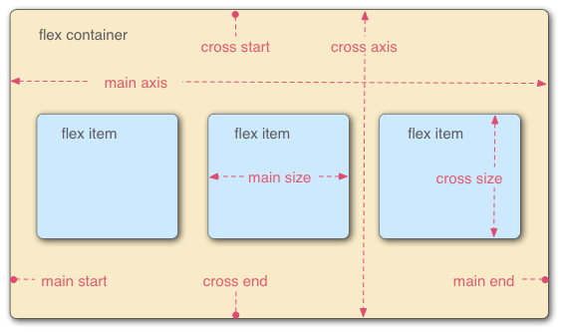
Flex

Slide 11
Grid

Slide 12
Grid
.wrapper {
display: grid;
grid-template-columns: 1fr 1fr;
grid-column-gap: 1px;
grid-row-gap: 1px;
background-color: black;
grid-template-rows: 1fr 3fr;
}

Slide 13
Float
img {
float: right;
}

Slide 14
Position
static
relative
fixed
absolute
sticky

Slide 15
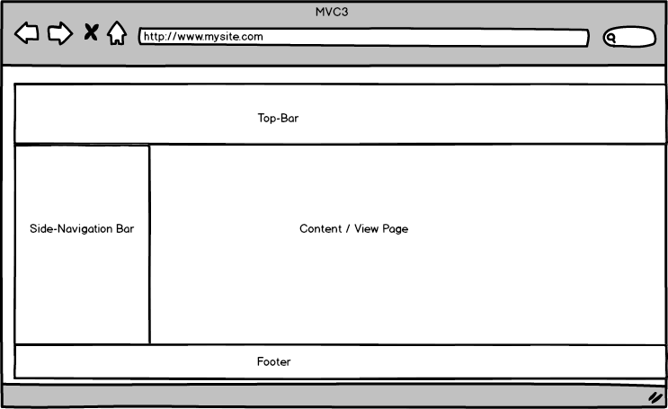
Pozicija i slaganje

Slide 16
„Responsive“ dizajn

Slide 17
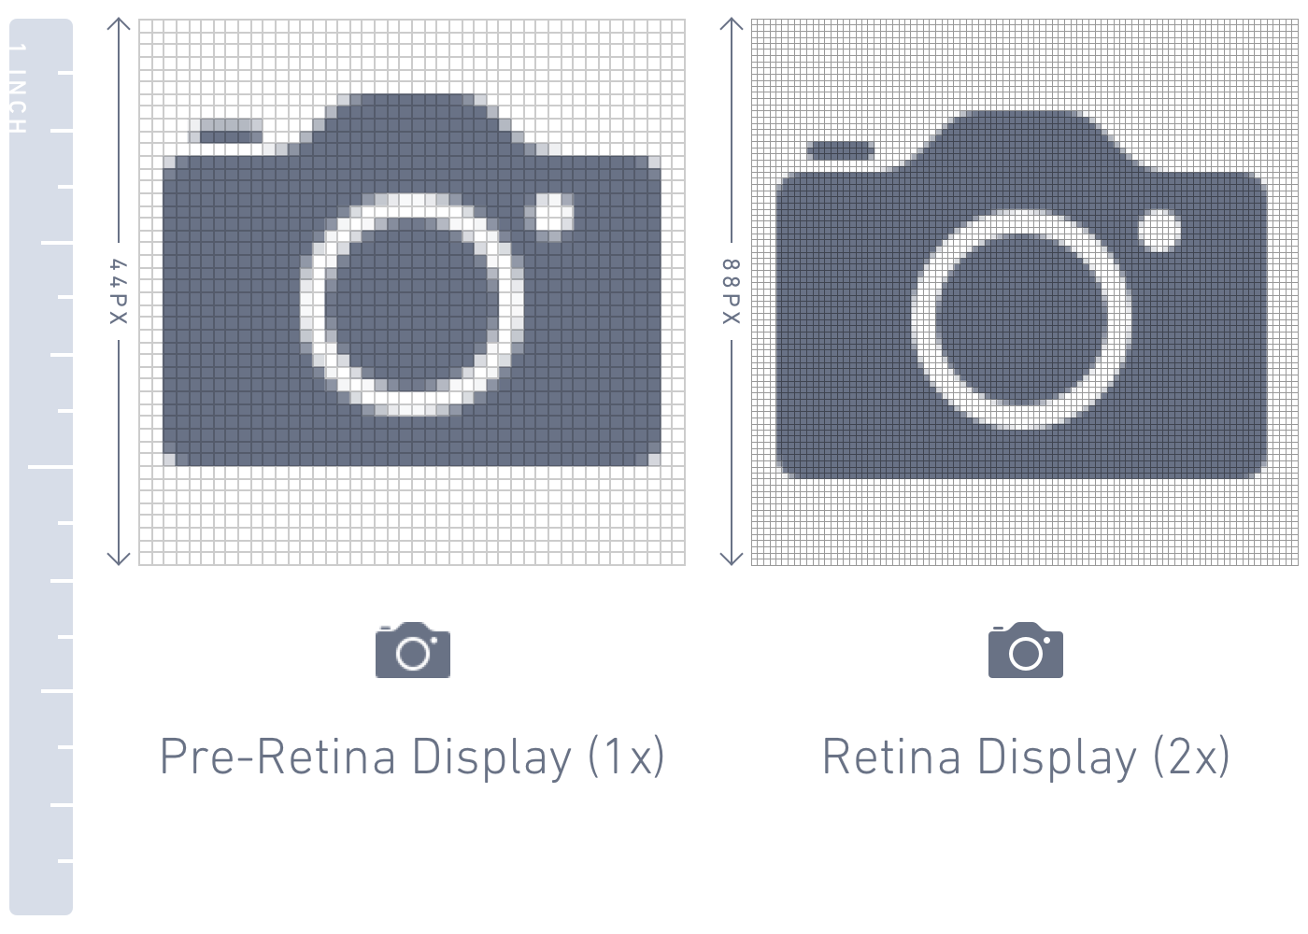
PPI/PPCM – Pixel per inch/cm

Slide 18
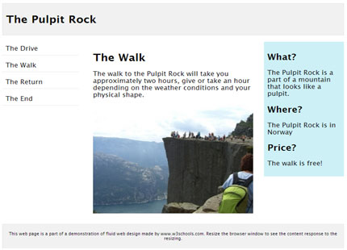
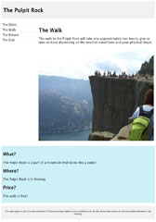

„Responsive“ dizajn

Slide 19
„Responsive“ dizajn
<meta name="viewport" content="width=device-width, initial-scale=1.0">
<h1 style="font-size:10vw">Hello World</h1>
<img src="img_girl.jpg" style="width:100%;">
<img src="img_girl.jpg" style="max-width:100%;height:auto;">
<picture>
<source srcset="img_smallflower.jpg" media="(max-width: 600px)">
<source srcset="img_flowers.jpg" media="(max-width: 1500px)">
<source srcset="flowers.jpg">
<img src="img_smallflower.jpg" alt="Flowers">
</picture>
@media screen and (max-width: 800px) {

Slide 20
Media queries

Slide 21



Media queries

Slide 22
Media queries
/* Extra small devices (phones, 600px and down) */
@media only screen and (max-width: 600px) {...}
/* Small devices (portrait tablets and large phones, 600px and up) */
@media only screen and (min-width: 600px) {...}
/* Medium devices (landscape tablets, 768px and up) */
@media only screen and (min-width: 768px) {...}
/* Large devices (laptops/desktops, 992px and up) */
@media only screen and (min-width: 992px) {...}
/* Extra large devices (large laptops and desktops, 1200px and up) */
@media only screen and (min-width: 1200px) {...}

Slide 23
Vežbe

Slide 24
Vežba 1

Slide 25

Vežba 2

